Slide 1
Blueprints (python- flask application ) Task 2
Scalable application- using Blueprints- T level Year 2

Slide 2
NOTE
This is teacher led coding session, the code in this PPT might not work for beginner.

Slide 3
Navigation Bar (H.W)
. Show your wok on your PC

Slide 4
Recap(15 minutes)
What database are we using for making an application?
What is Sqlalchmy?
What ORM?

Slide 5
So far we have covers
CRUD operation app ( code with PPT available on Moodle )
Authentication app ( code with PPT available on moodle )

Slide 6
Toaday's session
MVC ( model control view)
Flask Blueprints

Slide 7
MVC (Model View Control)
MVC is a way to organize how an app works. It splits the app into three parts:
Model: Handles the data.
View: Shows the data to the user (like the screen you see).
Controller: Takes user actions (like clicks), updates the data, and tells the View to refresh.
This keeps things organized and makes it easier to update or fix parts of the app.

Slide 8
Blueprints in flask
Blueprint in Flask: Helps organise your app into separate sections.
Example:
"auth" blueprint: Manages login/signup.
"reservation" blueprint: Handles bookings.
Each blueprint has its own routes and views, making the app easier to manage.

Slide 9
How blueprints and MVC are relevant?
Blueprints in Flask help organie your app into different parts, like splitting it into sections (e.g., login or reservations).
MVC (Model-View-Controller) is a pattern for separating the app into three parts: data (Model), user interface (View), and logic (Controller).
How they’re related:
Blueprints can help organie your app’s Controller (the logic part) in Flask.
Both make apps easier to manage by separating different parts, whether it’s features (blueprints) or app structure (MVC).

Slide 10
In this session we will have hands on experience with blueprints.
Next lesson we would work on MVC

Slide 11
Can you try to write a simple code for running sever for flask!

Slide 12
If not, we can do it together

Slide 13
Simple code for flask
Make two routes , one with name"auth" and other with name "app"

Slide 14
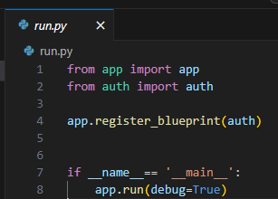
Run.py

Slide 15
Explanation
from app import app: Imports the main app to run the web application.
from auth import auth: Imports the auth blueprint to handle user authentication.
app.register_blueprint(auth): Adds the auth blueprint to the app for handling login/signup.
if __name__ == '__main__':: Runs the app only if this file is executed directly.
app.run(debug=True): Starts the app with debugging enabled for easier error fixing.

Slide 16
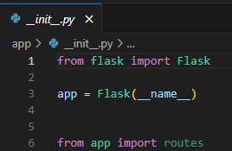
App's __init__.py

Slide 17
Expalnation
from flask import Flask: Imports Flask to create the web application.
app = Flask(__name__): Creates an app instance using Flask, setting up the web application.
from app import routes: Imports the routes (URL handling) from the app file to define what the app will do for different requests.

Slide 18
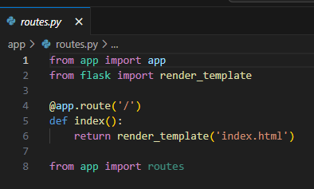
App's route.py

Slide 19
Explaintion
from app import app: Imports the main app instance.
from flask import render_template: Imports the function to render HTML templates.
@app.route('/'): Defines the main route (home page) of the app.
def index():: Creates the function that runs when the home page is accessed.
return render_template('index.html'): Renders and returns the index.html template when the home page is accessed.
from app import routes: Imports the routes from the app file (defines how different pages are handled).

Slide 20
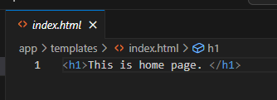
App's index.html

Slide 21
Explanation
<h1>This is home page.</h1>:
This is an HTML tag that displays the text "This is home page." as a large heading (h1) on the web page.

Slide 22
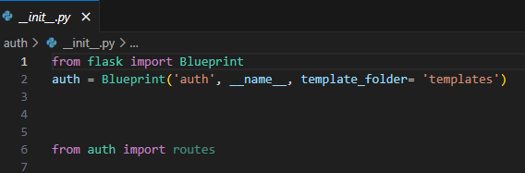
Auth' __init__.py

Slide 23
Explanation
from flask import Blueprint: Imports Blueprint to organize the app into smaller parts.
auth = Blueprint('auth', __name__, template_folder='templates'):
Creates a blueprint called auth.
template_folder='templates' specifies where the templates for this blueprint are stored.
from auth import routes: Imports routes from the auth blueprint, defining how user-related pages (login, signup, etc.) will work.

Slide 24
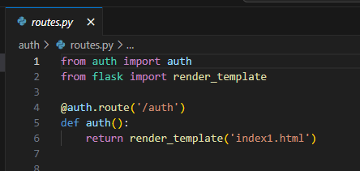
Auth's route.py

Slide 25
Expalanation
from auth import auth: Imports the auth blueprint to handle authentication-related routes.
from flask import render_template: Imports the function to render HTML templates.
@auth.route('/auth'): Defines a route /auth that triggers when the URL path is /auth.
def auth():: Defines the function that runs when the /auth route is accessed.
return render_template('index1.html'): Renders the index1.html template when the /auth route is accessed.

Slide 26
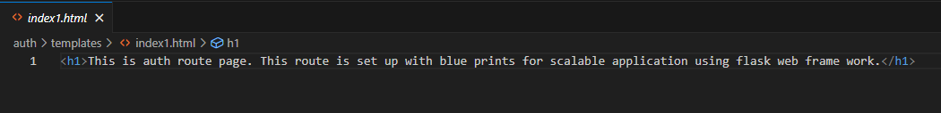
Auth' index.html

Slide 27
Explanation
<h1>This is auth route page...</h1>:
This is an HTML heading (h1) that displays the text as a large heading on the web page.
The message explains that this page is part of the auth route, and the application is set up with blueprints for scalability in Flask.

